Slide 1

Digital Logic Design

Slide 2
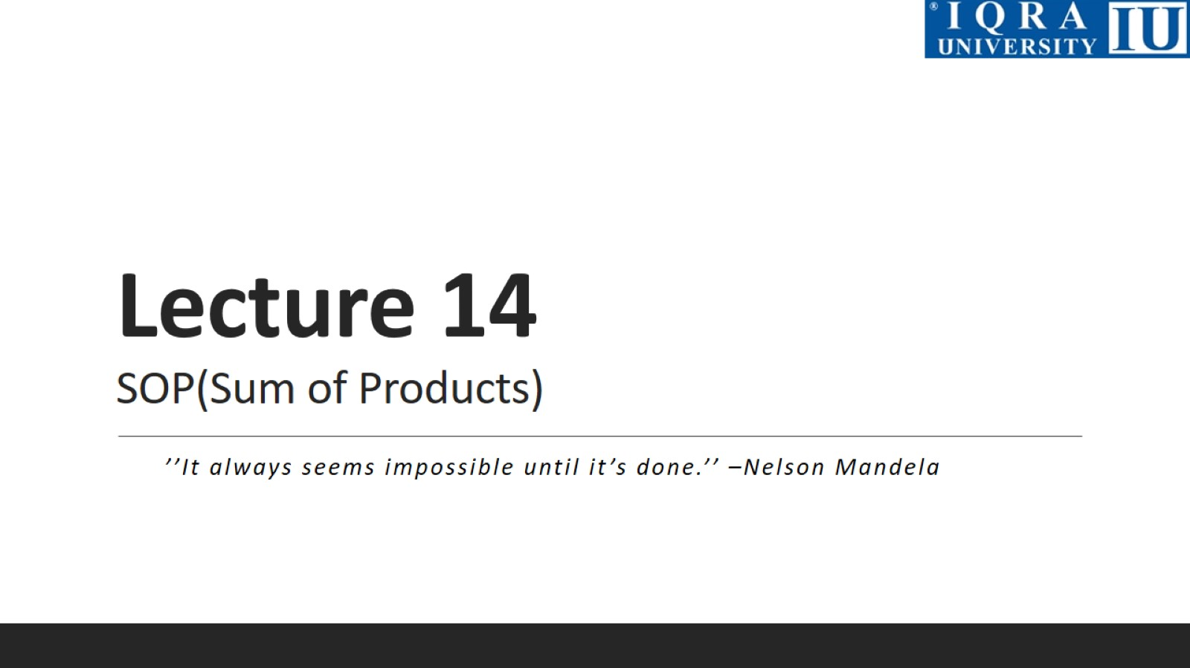
Lecture 14 SOP(Sum of Products)

Slide 3
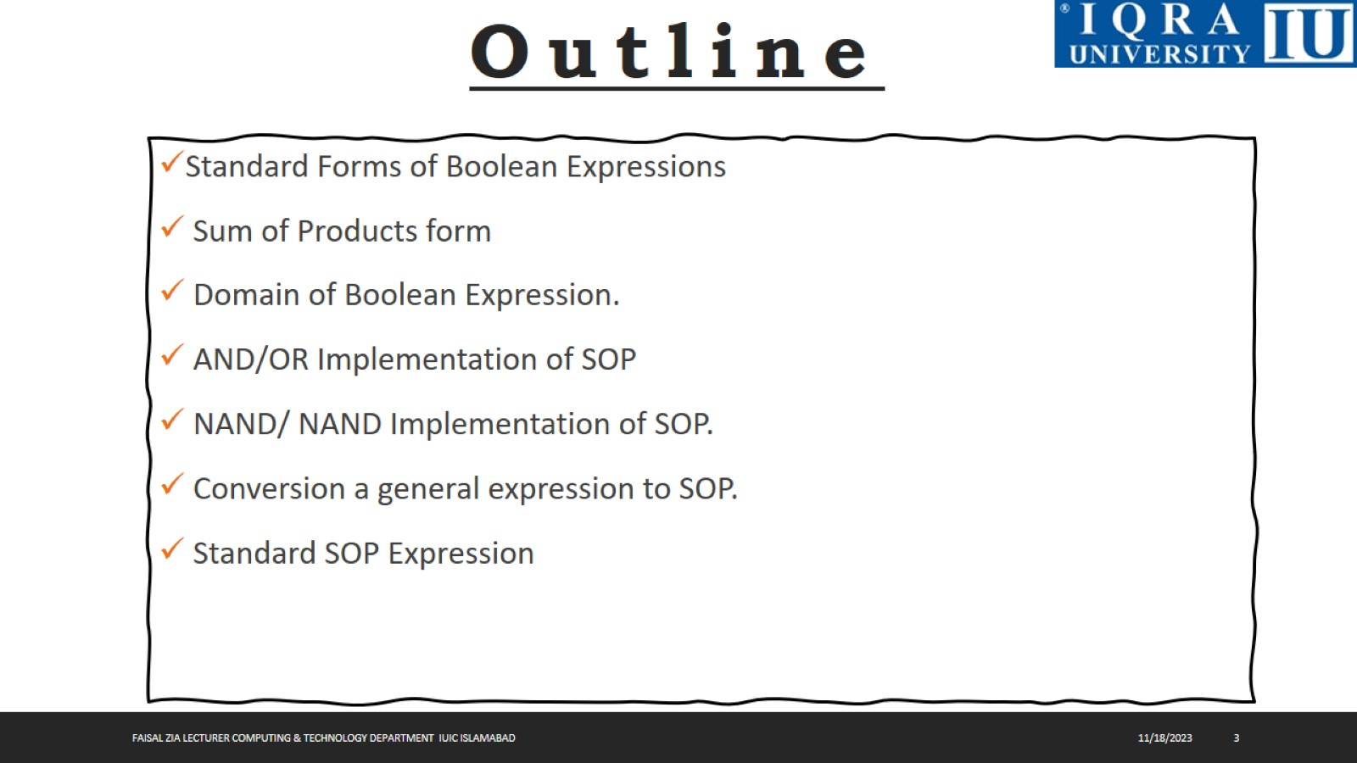

Slide 4
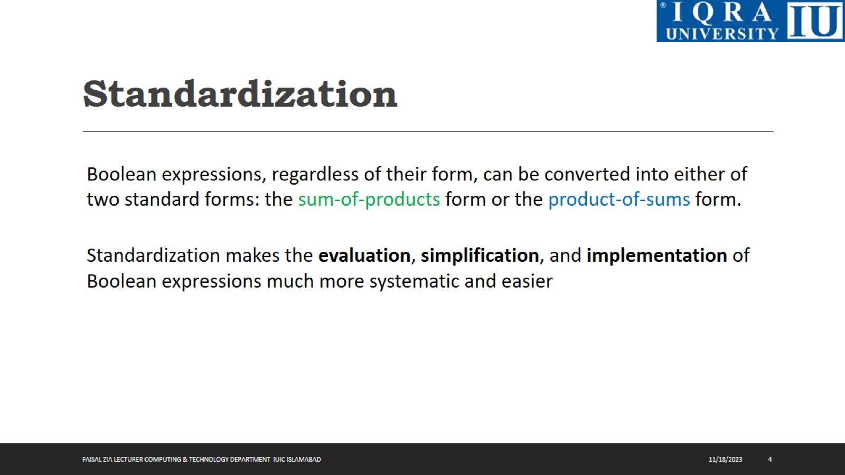
Standardization

Slide 5
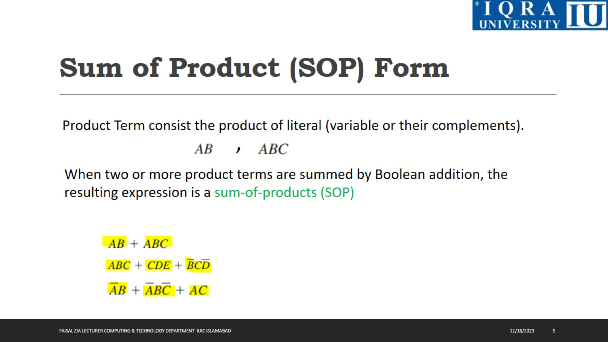
Sum of Product (SOP) Form

Slide 6
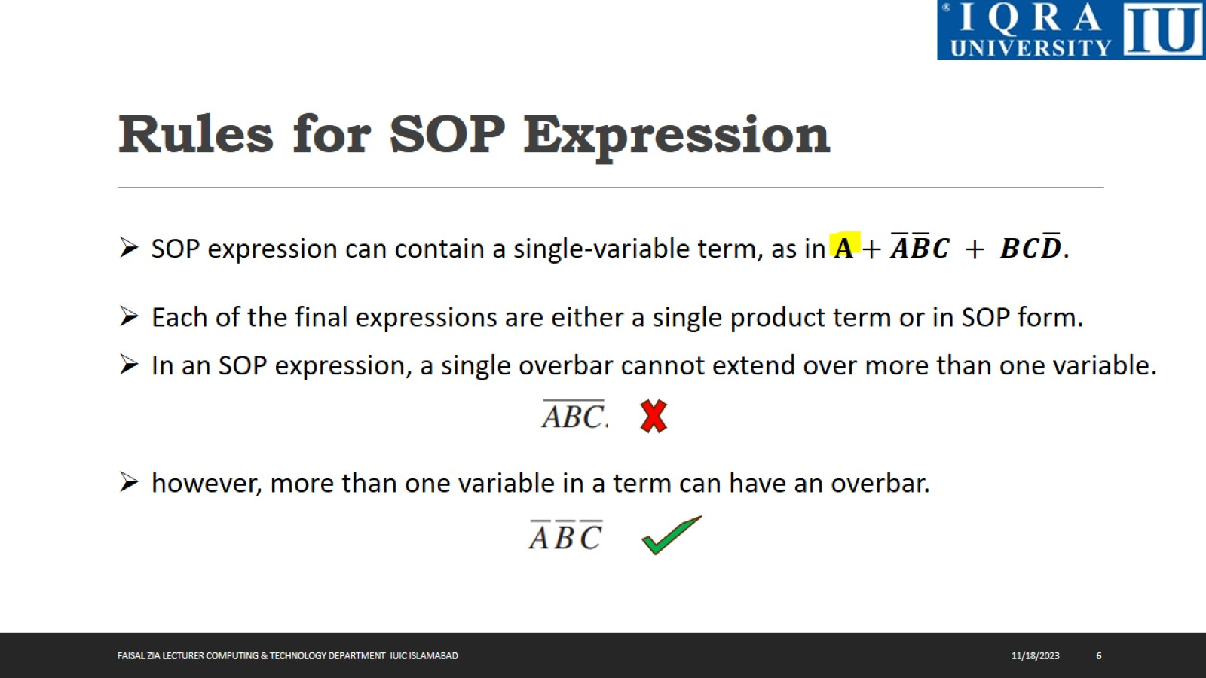
Rules for SOP Expression

Slide 7
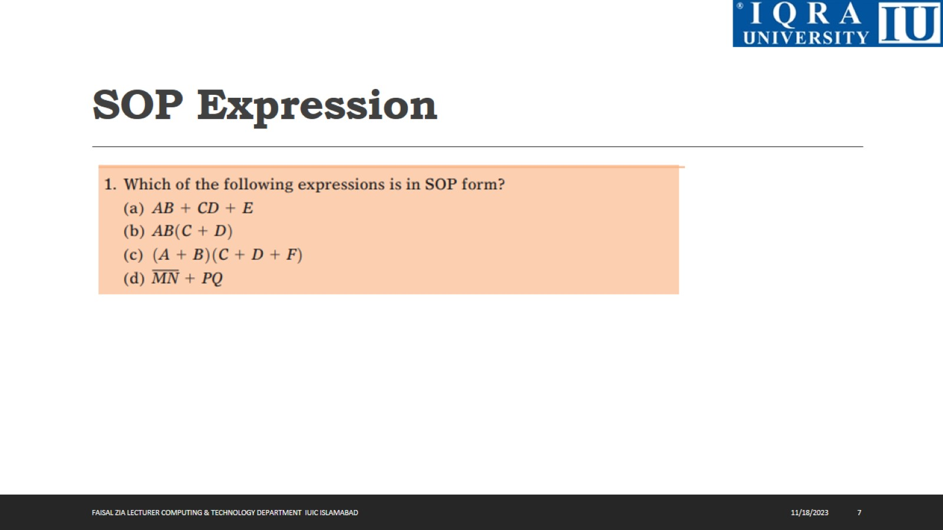
SOP Expression

Slide 8
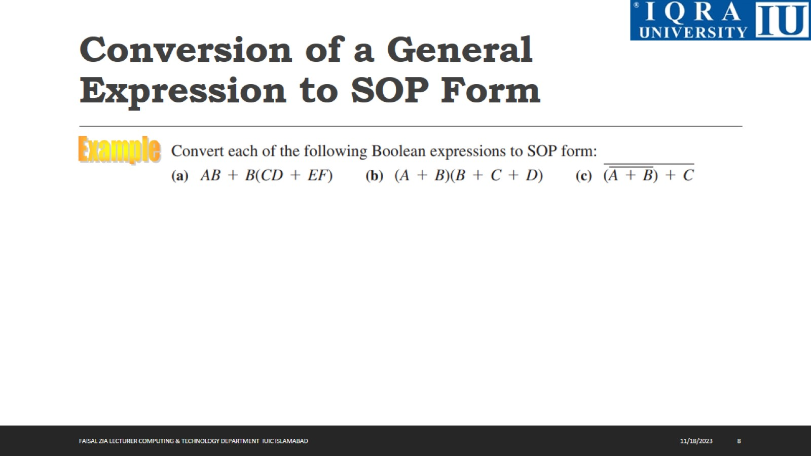
Conversion of a General Expression to SOP Form

Slide 9
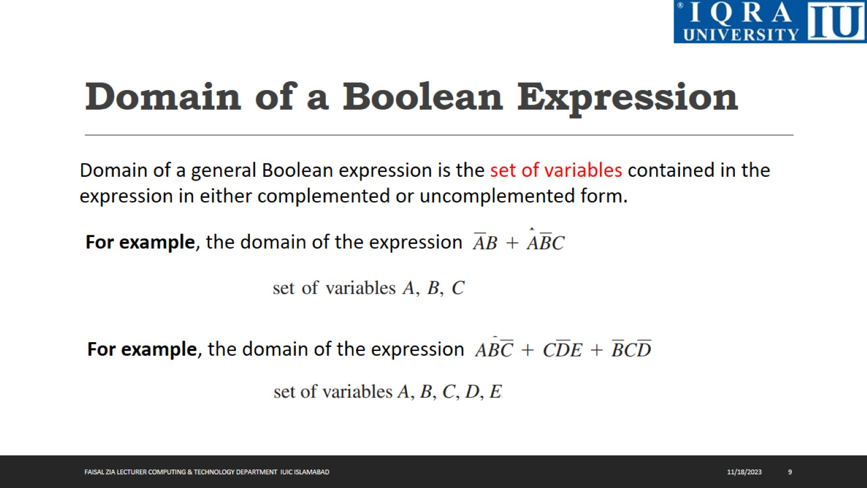
Domain of a Boolean Expression

Slide 10
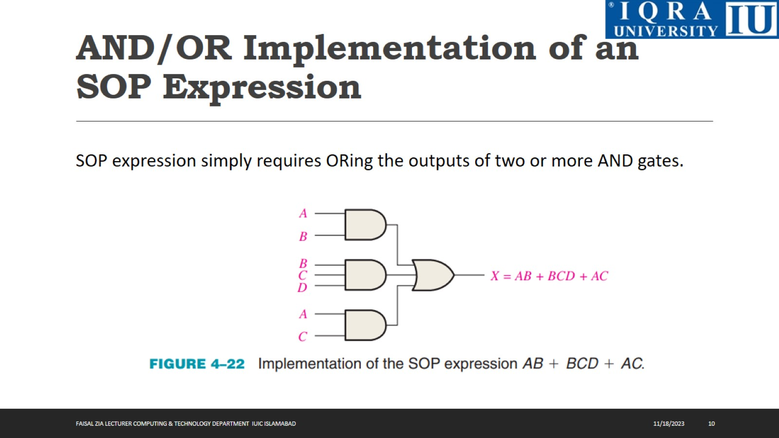
AND/OR Implementation of an SOP Expression

Slide 11
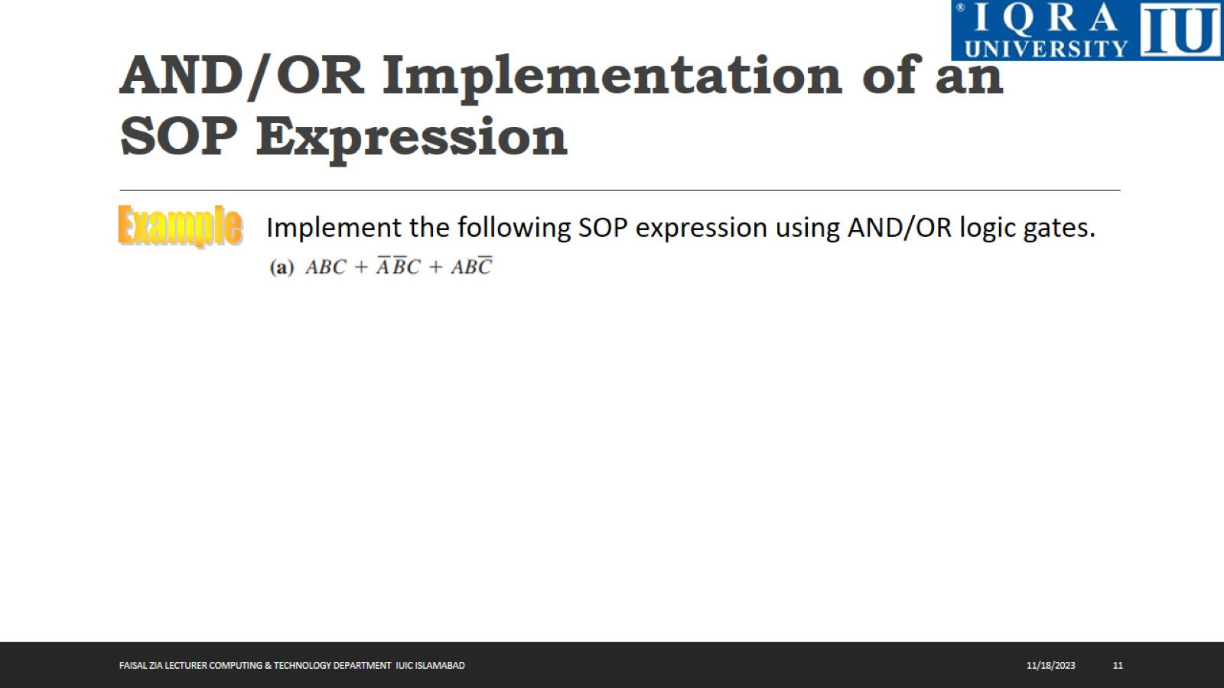
AND/OR Implementation of an SOP Expression

Slide 12

AND/OR Implementation of an SOP Expression

Slide 13
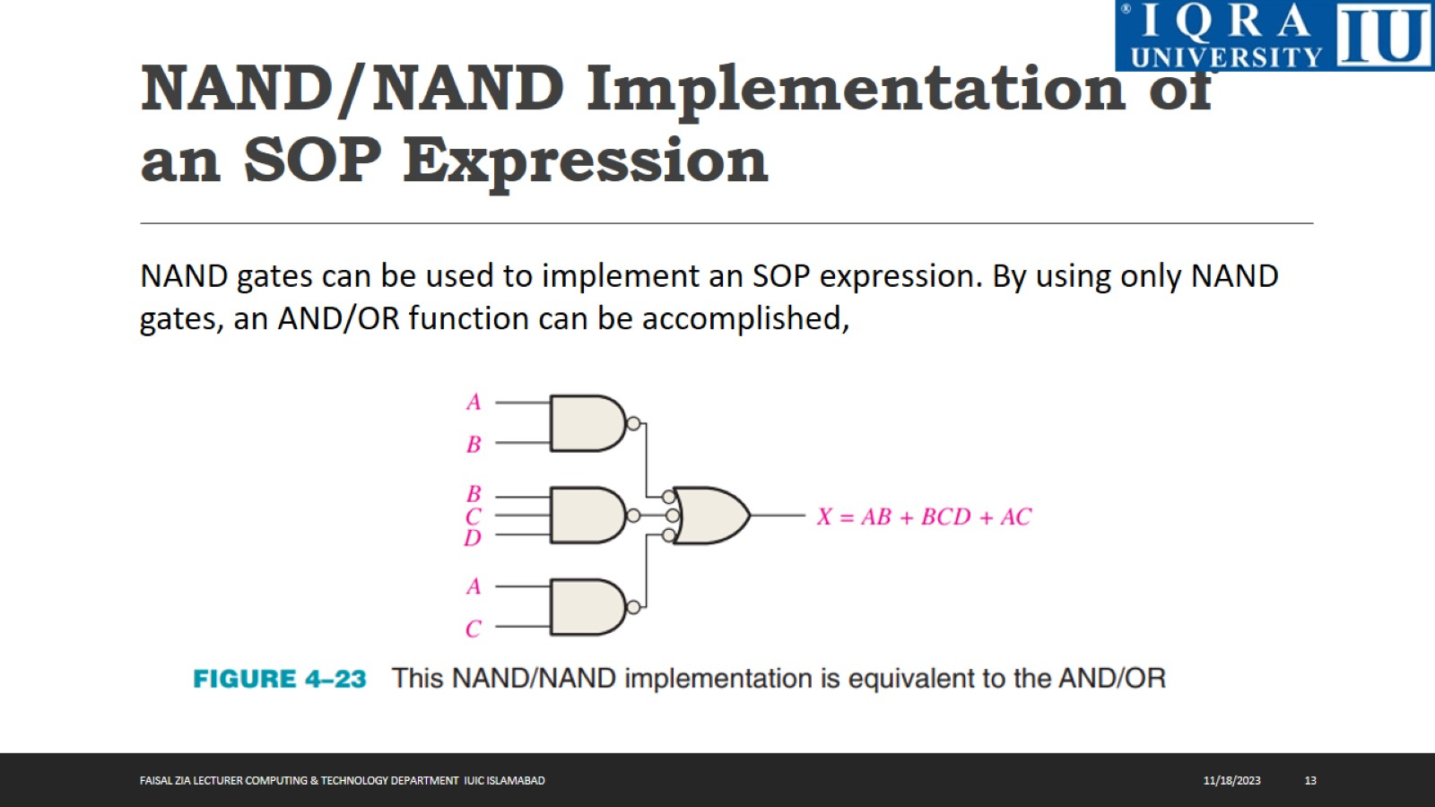
NAND/NAND Implementation of an SOP Expression

Slide 14
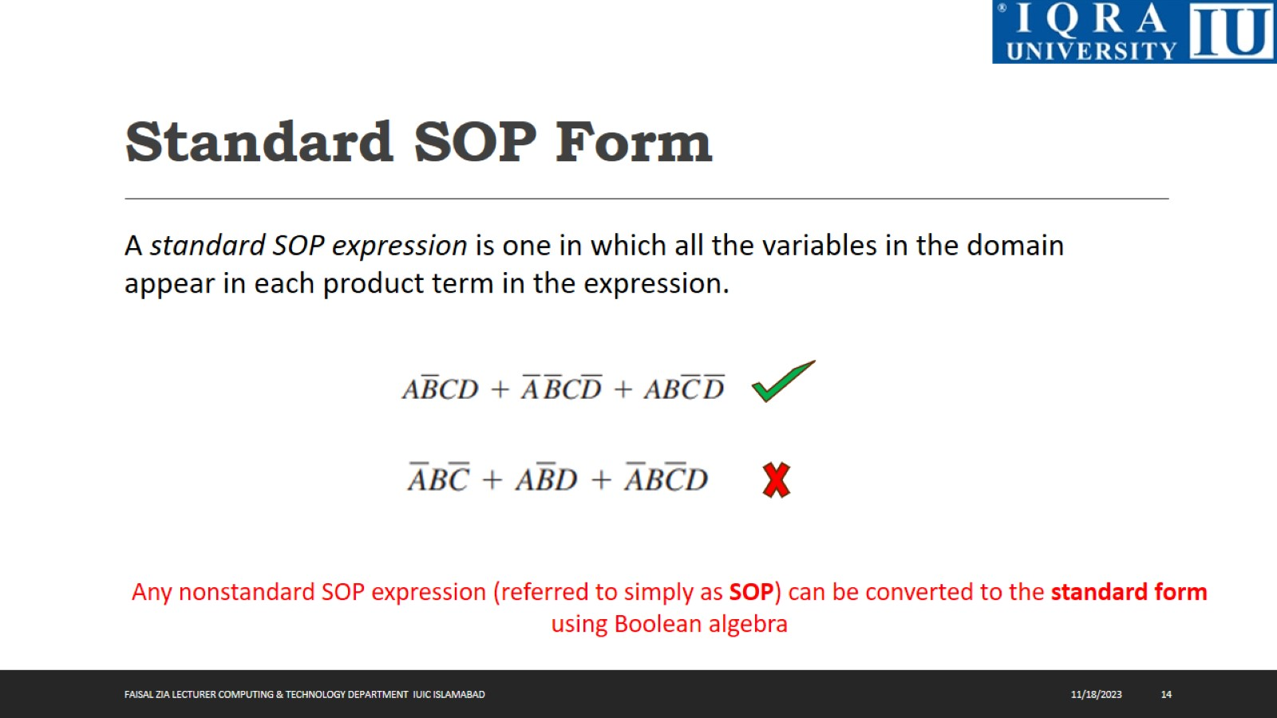
Standard SOP Form

Slide 15
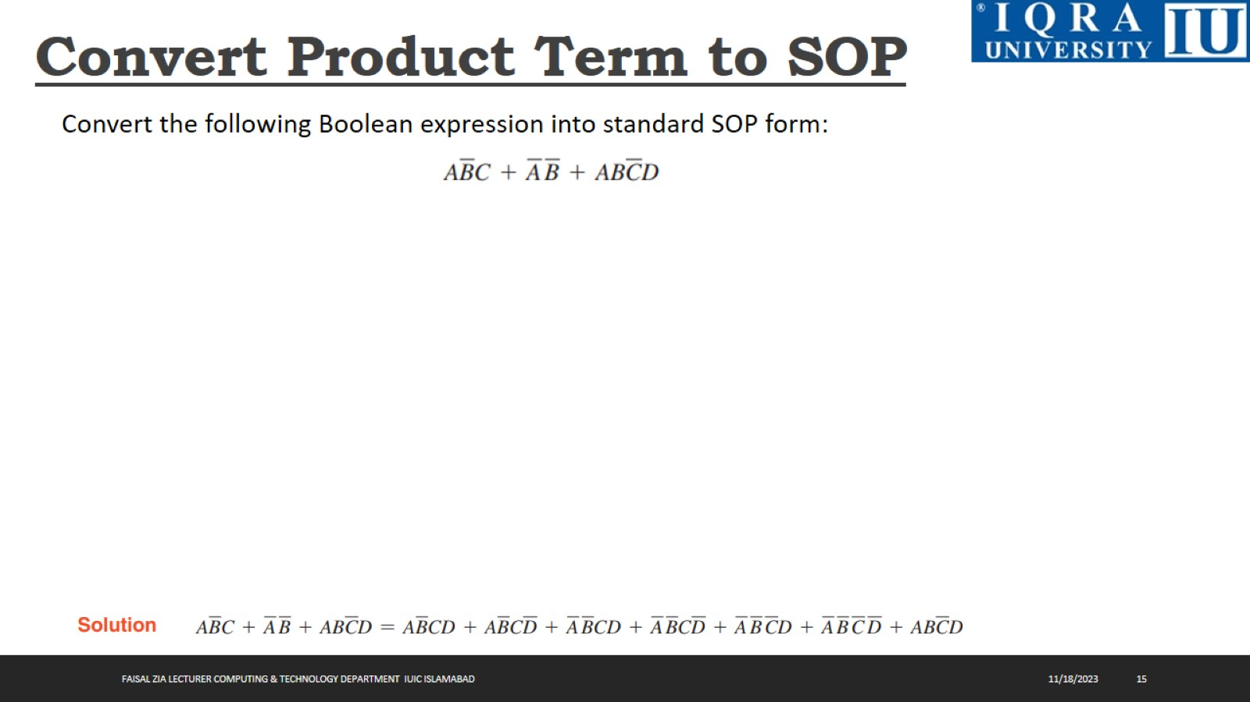
Convert Product Term to SOP

Slide 16
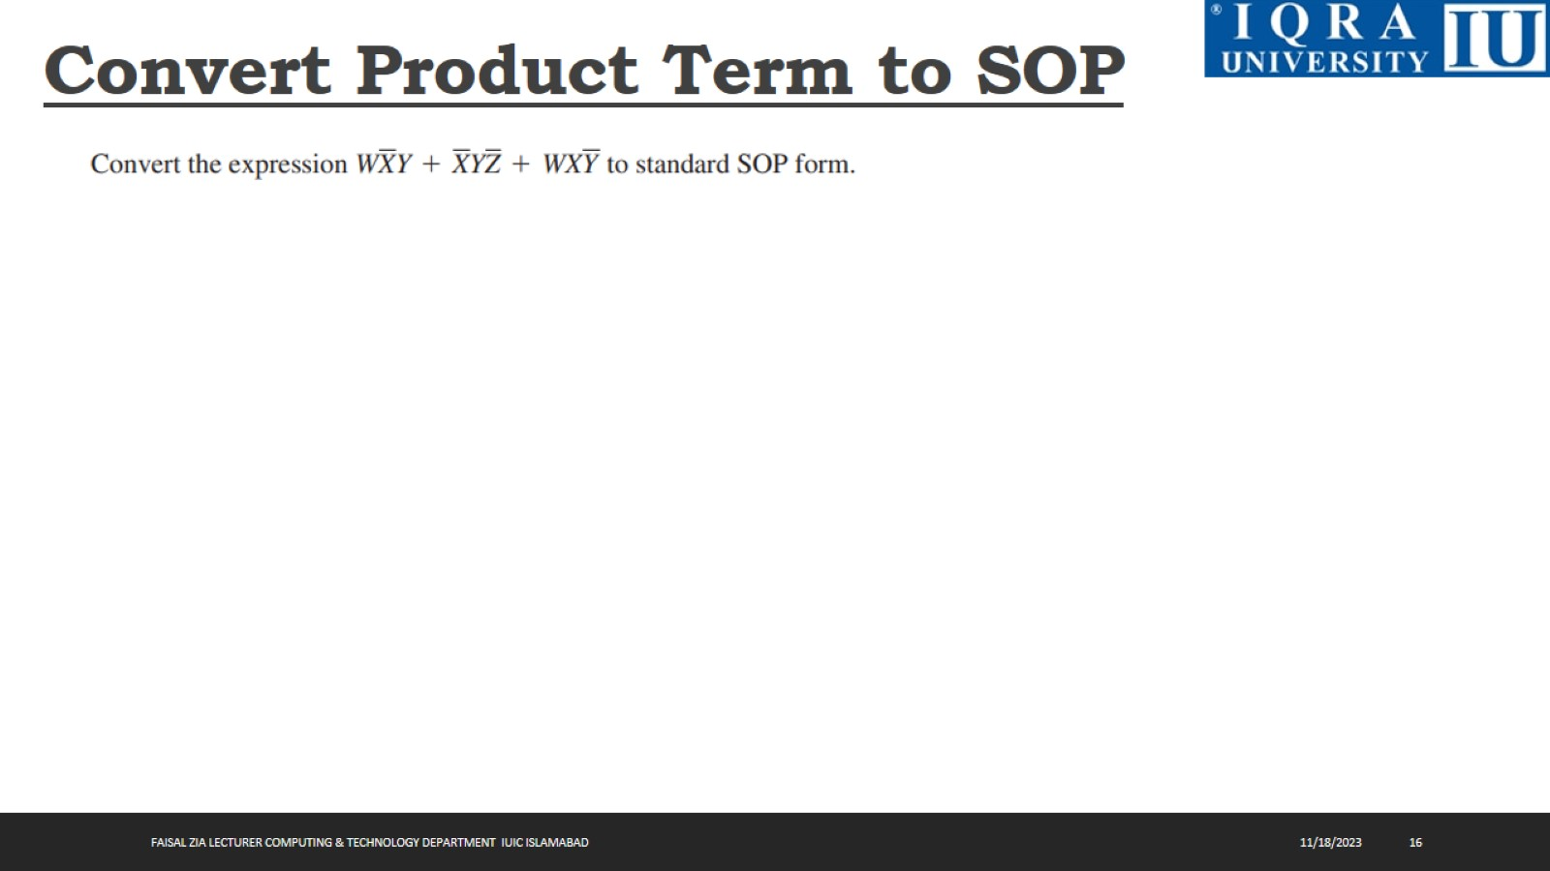
Convert Product Term to SOP

Slide 17
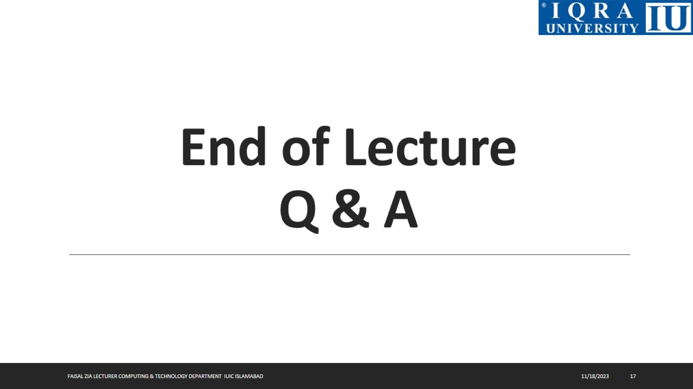
End of Lecture Q & A

